Slide 1
Animation & Graphics
Lecture 8
Tom Karni, Itsik Avidan

Slide 2
Intro
Android provides verity of APIs for animation and graphics
Animations :
Drawable animation
View animation
Property animation
Graphics :
2D – Canvas & Drawable
3D - OpenGL

Slide 3
Drawable Animation
Load a series of sequence Drawables one after another to create an animated movie
Define the animation with a single *.XML file
Place the file under res/drawable/ directory
<animation-list> tag - the root node
<item> tag – define a single frame – source and duration

Slide 4
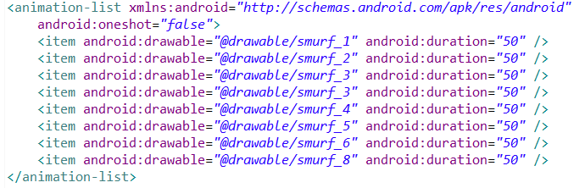
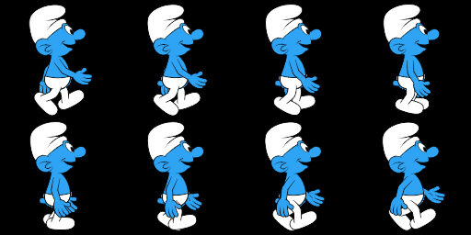
Drawable Animation

Slide 5
Drawable Animation
The animation binding and rendering is made using the AnimationDrawable API
The defined *.XML file can be added as the image background to a view and than called to play
The start() method can’t be called during the Activity’s onCreate() since the view binding isn’t necessarily completed, use onWindowFocusChanges() instead

Slide 6
View Animation
View (Tweened) animation calculates the animation with information such as :
Start point
End point
Rotation
…
Performs a series of simple transformations on the View contents
Can be defined by a *.XML file or by code

Slide 7
View Animation
The *.xml file location is under the res/anim/ directory
Must contain a single root element and child elements
<alpha>
<scale>
<translate>
<rotate>
<set>

Slide 8
View Animation
You can select how animation will be applied over time by assigning an Interpolator
The animation is defined using the Animation API
The animation will be start by calling the View.startAnimation(Animation)

Slide 9
Canvas
When the application needs specialized drawings and/or control the animation
The Canvas represents the actual surface upon your graphics will be drawn
Can be drawn in 2 methods
On a View
On a SurfaceView

Slide 10
Canvas – on View
For applications that does not require a significant amount of processing or high frame-rate
Extend the View.class and implement the onDraw() method, this is where you will perform your calls to draw through the Canvas
Android FW will call onDraw() as necessary
Each time that your application is prepared to be drawn, you must request your View be invalidated by calling invalidate() and redraw it

Slide 11
Canvas – on SurfaceView
SurfaceView – subclass of View that offers a surface within the view
Enables the application to create the view in a worker thread and change the UI at its own pace

Slide 12
Canvas – on SurfaceView
Extend the SurfaveView.class and implement the SurfaceHolder.Callback interface which responsible for a notifying all of the Surface events
In the SurfaceView class define the worker thread that will perform all the drawing procedures to your Canvas
After the SurfaceView is initialized, get the surface holder by calling getHolder()
Add callbacks to the holder by calling addCallback() and override the SurfaceHolder.Callback methods

Slide 13
Canvas – on SurfaceView
In order to draw to the SurfaceView in the worker thread retrieve the Canvas with lockCanvas()
Draw to the canvas
Call unlockCanvasAndPost() to draw the Canvas on the View

Slide 14
Drawables
There are three ways to define and instantiate a Drawable
Saved image under project resources
Using *.xml file
Using Drawable.class

Slide 15
ShapeDrawable
When you want to dynamically draw some two-dimensional graphics
Can programmatically draw primitive shapes and style them in any way imaginable

Slide 16
References
Android developers [http://developer.android.com]

